Slide 1
Unit- 5 TECHNICAL TALK: MEANING, PROCEDURE, PRESENTATION
What is technical talk?
Technical talk is the presentation given by the people on certain topic.
Talking to a group of people is an important skill for the technical professional.
Some technical presentation are typical and good but many people are considered to be ill-prepared due to nervousness in speaking in front of the audiences.
So, in order to have a successful talk, it is necessary to prepare the talk first. For preparation of the presentation, writing manuscript is the first step.
However, before writing a talk/manuscript, we have to think about two elements which are:
Audiences:- Who are the audiences, why they are there and what they already knew. They may feel bored if we explain the things which they have known already.
Our purpose:- Audiences are curious to know about the purpose of the presentation.
Talk and Speech
Besides some similarities, there are some fundamental differences between talk and speech.
A talk is informative and interesting on a topic the speaker knows about and the audiences usually do not.
On the contrary, a speech is more persuasive and intends to dominate the audience by exploiting even misusing the facts.
In most cases, speech is biased, emotional and personal or subjective.
The purpose of talk is to inform whereas the purpose of the speech is persuade.
Politicians mostly use speech whereas managing directors use talk.

Slide 2
Ways of Presentation or Technical Talk
Generally, there are two ways in practice to deliver a talk to the audiences
Extemporaneous talk:- the speaker has already practice his/her talk at home and carries only the outline with keywords, statistics, quotation and some other very important ideas. When he/she is in front of the audiences, he or she speaks rather than reads. The speaker makes clear eye contact with the audiences and attract their attention towards subject matter.
Reading Prepared Manuscript (Reading directly):- Some speakers may have hesitation to speak in front of the audiences though they have a lot of information about the subject matter. These speakers mostly prepare manuscript at home at present to the audiences. In this type of talk, a speaker comes with a detailed manuscript and reads that in front of the audiences. There is little eye contact in this style.
Some steps of Writing out Manuscript
Begin with outline
Shape it to the time allotted dividing the presentation into introduction, body of text and conclusion. Suppose that you have 30 minute talk if you take 3 minutes for greeting, 3 minutes for conclusion and then 24 minutes for the body text.
Now decide how many ways you want to explain or elaborate your points. List them under the main discussion topic.

Slide 3
Example:
Introduction: statement of the argument
Body: Technical support for the argument
i.
ii.
(Restatement of points ‘i’ and ‘ii’ and relationship to argument)
iii.
iv.
v.
(Restatement of points ‘iii’, iv, v’ and restatement to argument)
3. Conclusion: Restatement of argument

Slide 4
How to make presentation
Greet the audiences and introduce yourself
I am……..Today I’m going to present my paper on………….
2. In my presentation, I’ll cover the following six points
Introduction of……..
The Landslide problem
Impact of landslide
Factors causing landslides
How to control landslides
Conclusion
To make your conclusion effective, following are the do’s and don’ts
Do’s
Be brief and to the point
Remind the listeners of what you have presented
Concluding signals…….In conclusion in closing, to conclude, to sum up etc.
Don’ts
Don’t surprise the audiences by telling ‘I guess’ ‘That’s all’ ‘That’s it’ etc.
Don’t just quit the dias rather say ‘I will be glad to answer the audiences’ if any and ‘Thank you very much’.
A model od Technical Talk entitled ‘The management of landslide in mountainous are’ is given below:

Slide 5
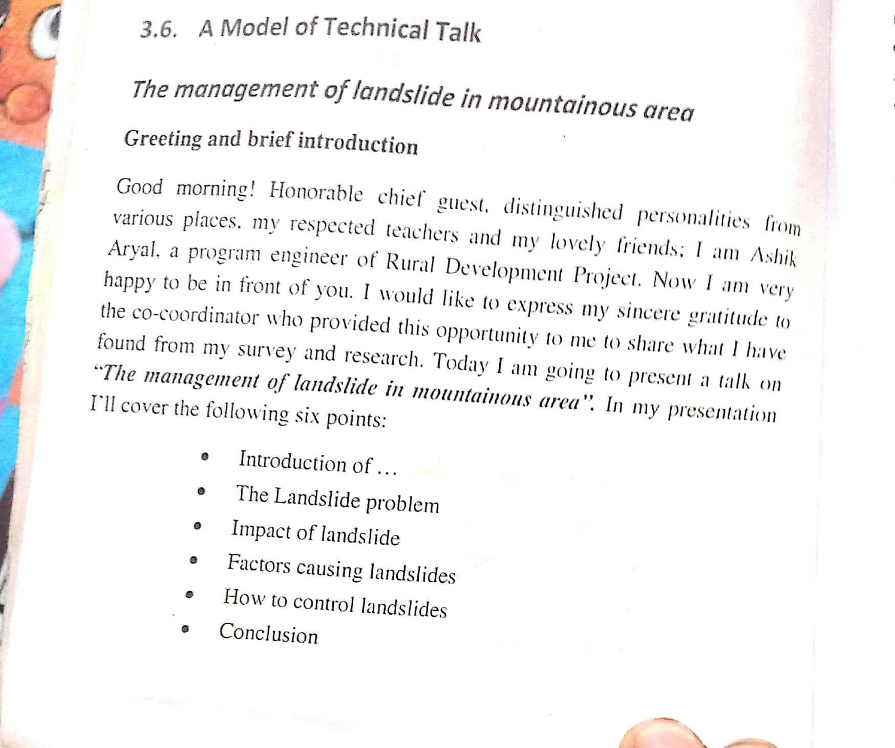
Soft Skills in Communication

Slide 6
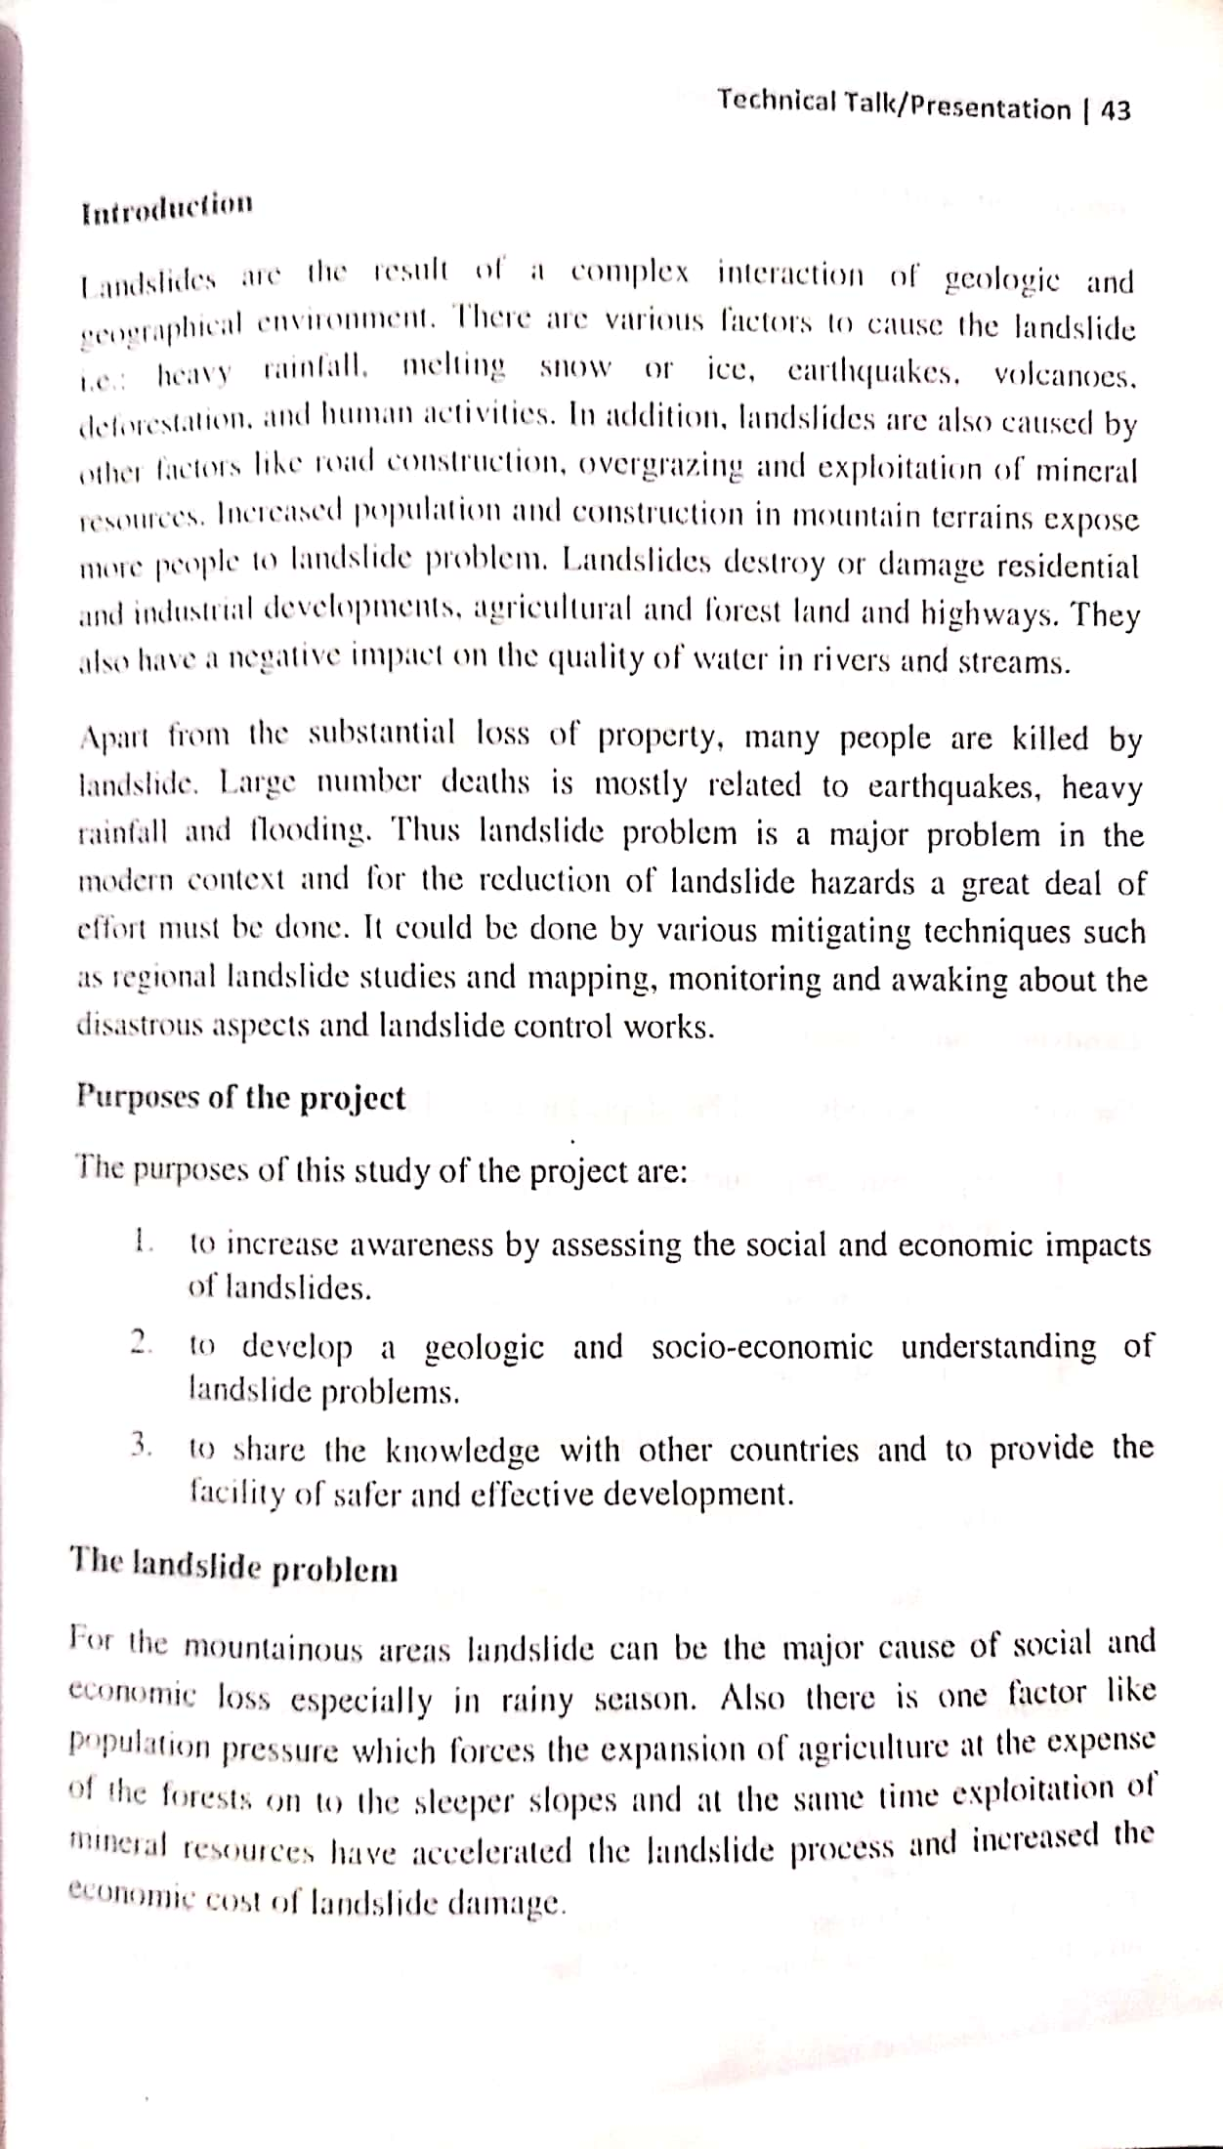

Slide 7
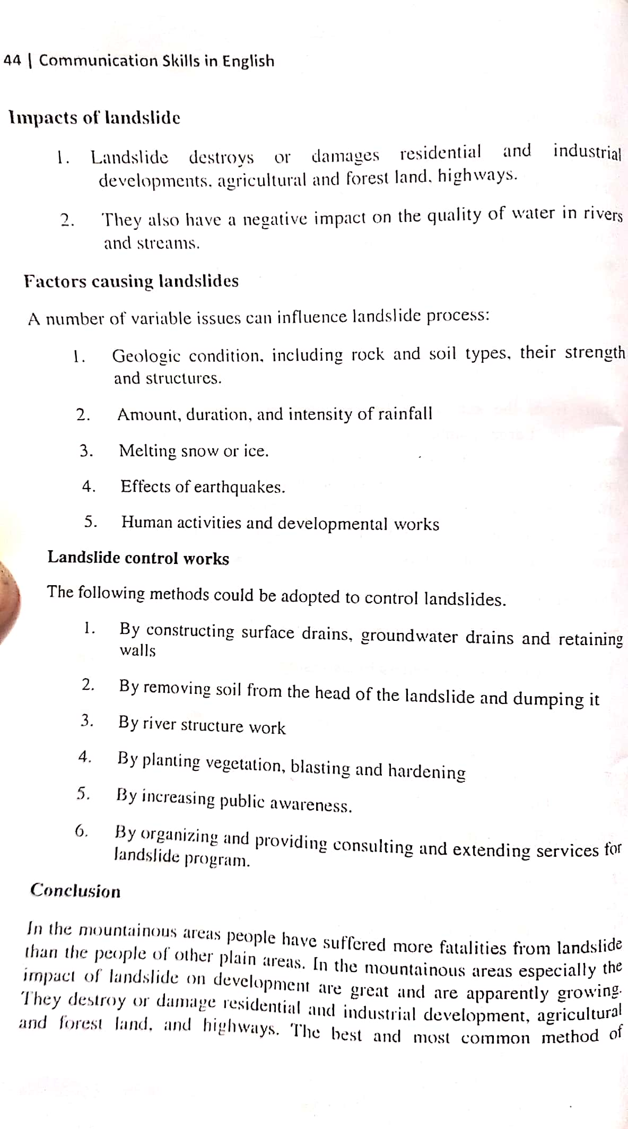

Slide 8
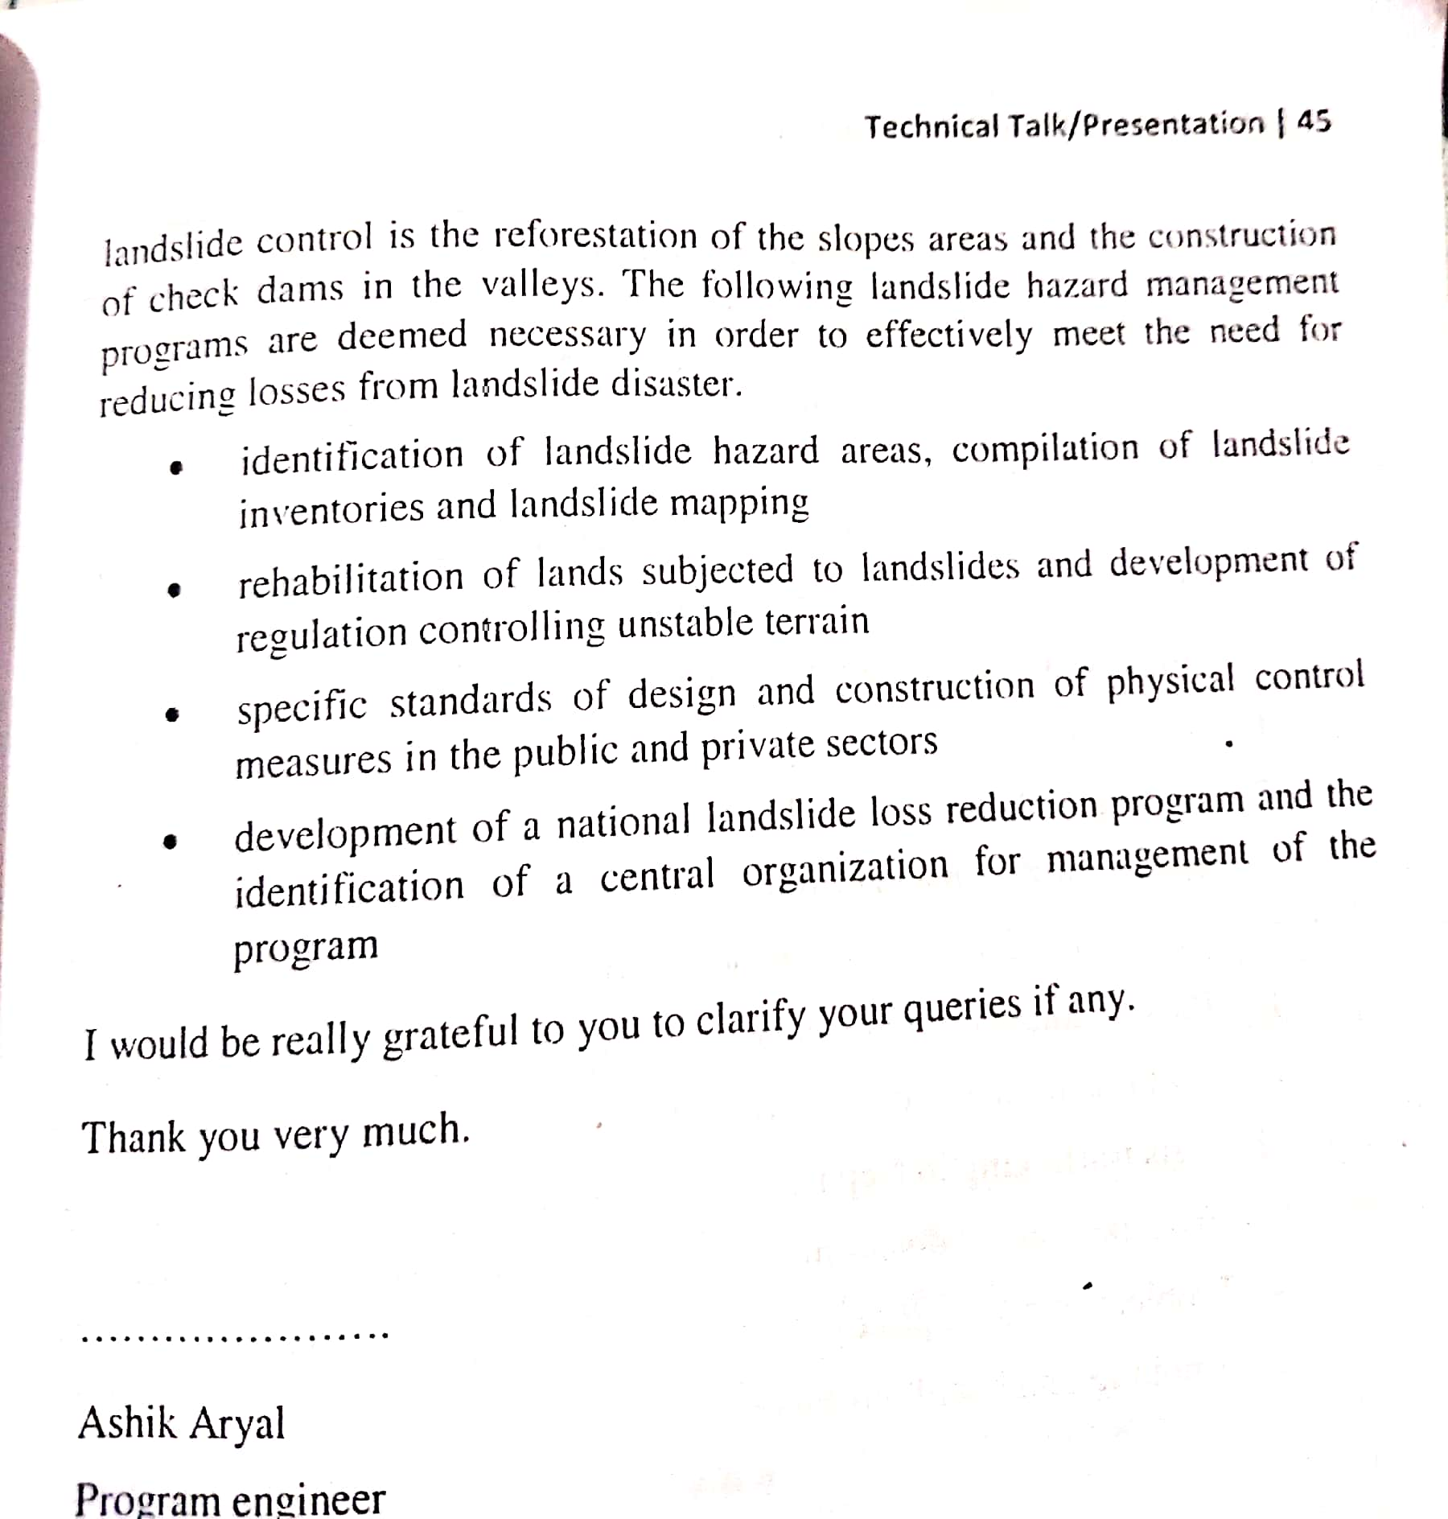

Slide 9
Some tips for presentation:-
Smile passionately
Smart dress up
Cleanliness
Body gestures
Eye contact
Seek audience participation
Make hand outs available if possible
Use of statistical data
Use of audio visual data
Be on time
Some topics for technical talk/presentation to the students.
The management of landslide in mountainous area (already done)
Mobile
Television
Computer
Urbanization
Banking
Promotion of business

